Slide 1
Algebraic Structures
by
Dr. T. M. Rajalaxmi
Assistant Professor
Department of Mathematics

Slide 2

Definition: Binary Operation
Let $S$ be a non-empty set.
A binary operation $∗$ on $S$ is a function $∗:S x S→S.$
The image of any ordered pair $(a,b)$ of elements of $S$ under $∗$ is denoted by $a∗b.$

Slide 3

Definition: Closed Operation
A binary operation is said to be closed on a non empty set $A,$if $a∗b∈A$, $∀ a,b∈A$ (closure property)
e.g. $ℕ$ closed with respect to addition and multiplication

Slide 4

Definition: Algebraic System
A set $S$ with one or more binary operations defined on it is called an algebraic system.
e.g.
$$\left(ℕ, +, x\right);\left(ℤ,+,−\right);(ℝ, +,⋅,−)$$

Slide 5
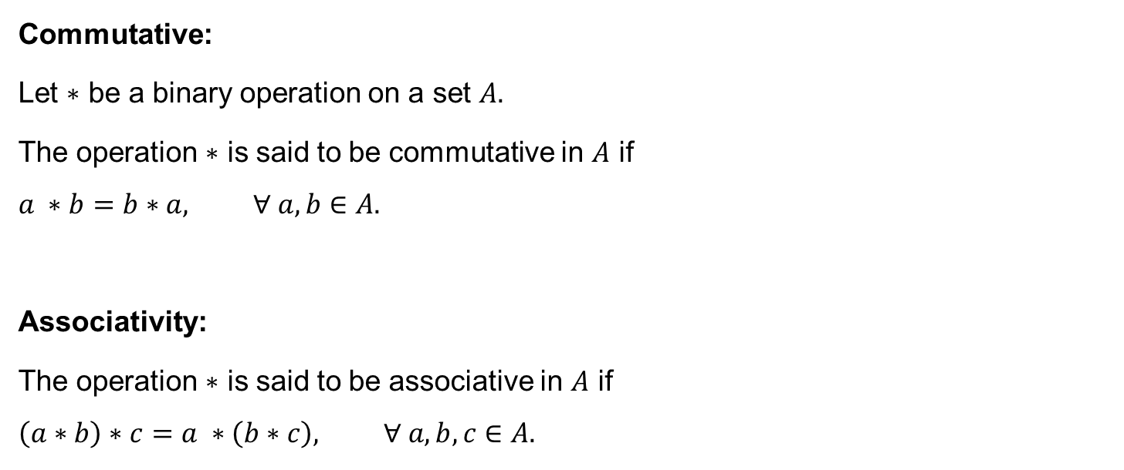
Properties
Commutative:
Let $∗$ be a binary operation on a set $A.$
The operation $∗$ is said to be commutative in $A$ if
$$a ∗b=b∗a, ∀ a, b∈A.$$
Associativity:
The operation $∗$ is said to be associative in $A$ if
$$\left(a∗b\right)∗c=a ∗\left(b∗c\right), ∀ a, b,c∈A.$$

Slide 6
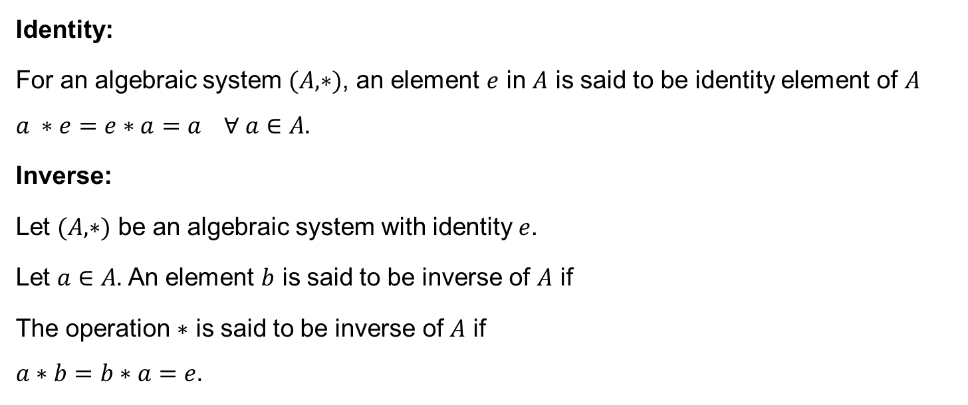
Properties
Identity:
For an algebraic system $(A,∗)$, an element $e$ in $A$ is said to be identity element of $A$
$$a ∗e=e∗a=a ∀ a∈A.$$
Inverse:
Let $(A,∗)$ be an algebraic system with identity $e$.
Let $a∈A.$ An element $b$ is said to be inverse of $A$ if
The operation $∗$ is said to be inverse of $A$ if
$$a∗b=b∗a=e.$$

Slide 7
Properties
Identity:
For an algebraic system $(A,∗)$, an element $e$ in $A$ is said to be identity element of $A$
$$a ∗e=e∗a=a ∀ a∈A.$$
Inverse:
Let $(A,∗)$ be an algebraic system with identity $e$.
Let $a∈A.$ An element $b$ is said to be inverse of $A$ if
The operation $∗$ is said to be inverse of $A$ if
$$a∗b=b∗a=e.$$

Slide 8

Semigroup
An algebraic system $(A, ∗)$ is said to be a semi group if
1. $∗$ is closed operation of $A.$
2. $∗$ is an associative operation $∀ a, b, c∈A.$
e.g. $(ℕ, +)$ is a semigroup.
$\left(ℤ, −\right)$ is not semigroup.

Slide 9
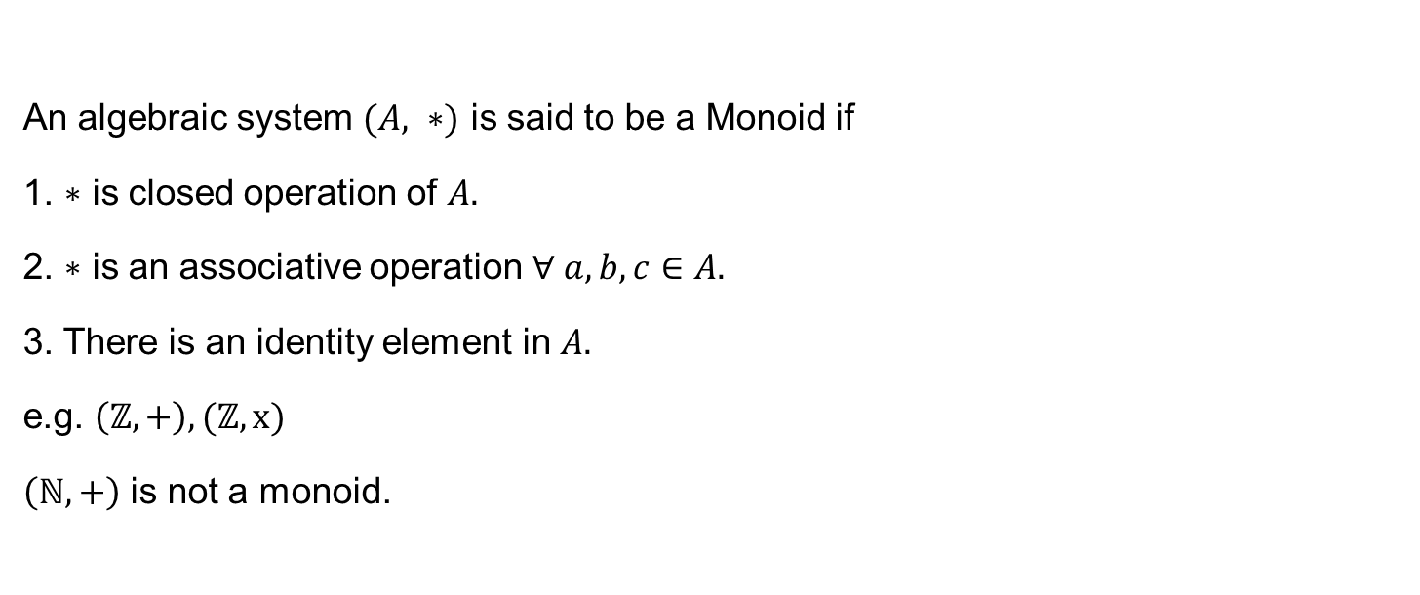
Monoid
An algebraic system $(A, ∗)$ is said to be a Monoid if
1. $∗$ is closed operation of $A.$
2. $∗$ is an associative operation $∀ a, b, c∈A.$
3. There is an identity element in $A.$
e.g. $\left(ℤ, +\right),(ℤ, x)$
$\left(ℕ, +\right)$ is not a monoid.

Slide 10

Commutative semigroup
Let $(S, ∗)$ be a semigroup.
It is said to be a commutative semigroup if
$∗$ satisfies the commutative property.
e.g. $\left(ℕ, +\right),(ℕ, x)$, $\left(ℤ, +\right)$.

Slide 11
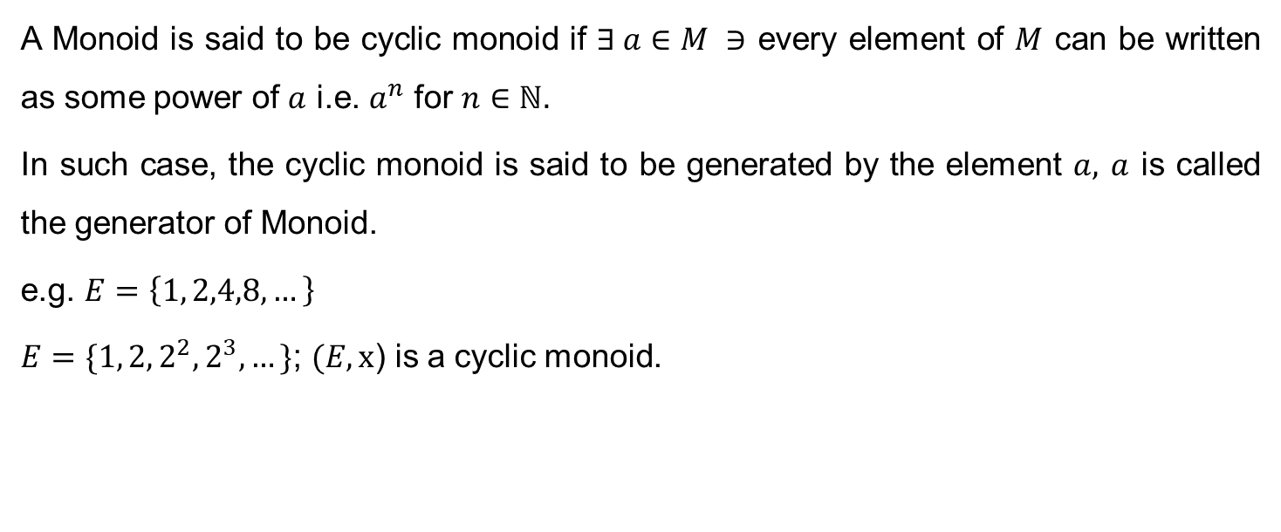
Cyclic Monoid
A Monoid is said to be cyclic monoid if $∃ a∈M ∋$ every element of $M$ can be written as some power of $a$ i.e. $a^{n}$ for $n∈ℕ.$
In such case, the cyclic monoid is said to be generated by the element $a,$ $a$ is called the generator of Monoid.
e.g. $E=\left\{1, 2,4,8,…\right\}$
$E=\{1, 2, 2^{2},2^{3},…\}$; $(E,x$) is a cyclic monoid.

Slide 12

Theorem: Every cyclic monoid is commutative.
Proof: Let $(M, x)$ be a cyclic monoid whose generator is $a∈M.$
Then for any $x, y∈M,$we have $x=a^{m}$, $y=a^{n}.$
$$x∗y=a^{m}∗a^{n}=a^{m+n}=a^{n}∗a^{m}=y∗x$$
$∴$ $(M, x)$ is commutative.

Slide 13
Problem:
Give an example to any semi group can be extended to a monoid by adjoining an identity element.

Slide 14
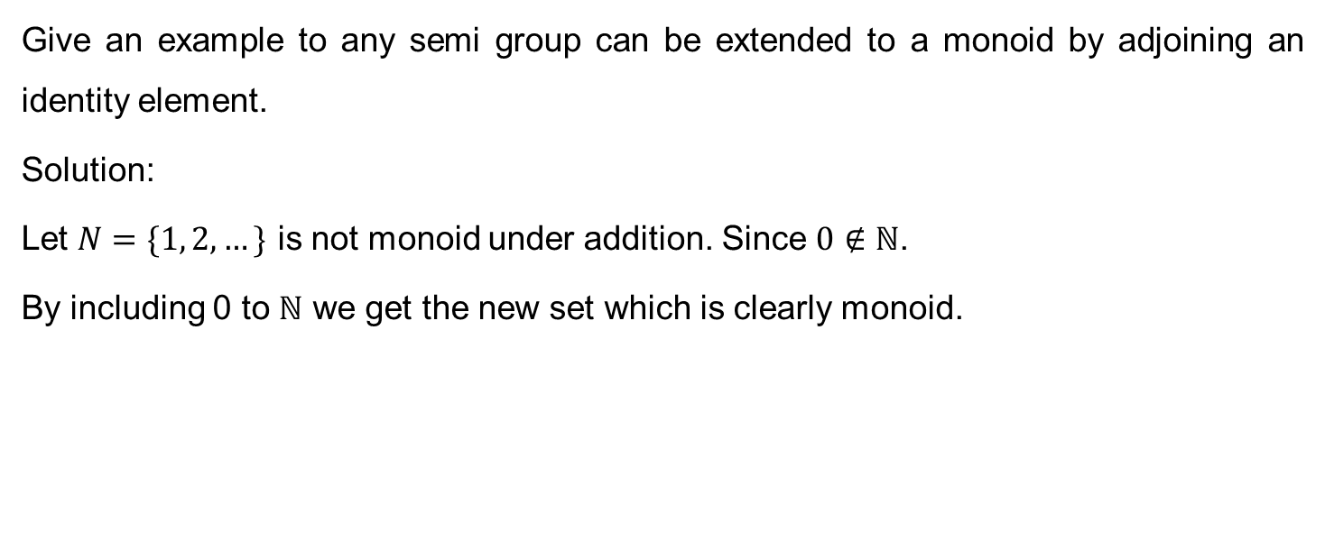
Problem:
Give an example to any semi group can be extended to a monoid by adjoining an identity element.
Solution:
Let $N=\{1, 2,…\}$ is not monoid under addition. Since $0∉ℕ$.
By including 0 to $ℕ$ we get the new set which is clearly monoid.

Slide 15
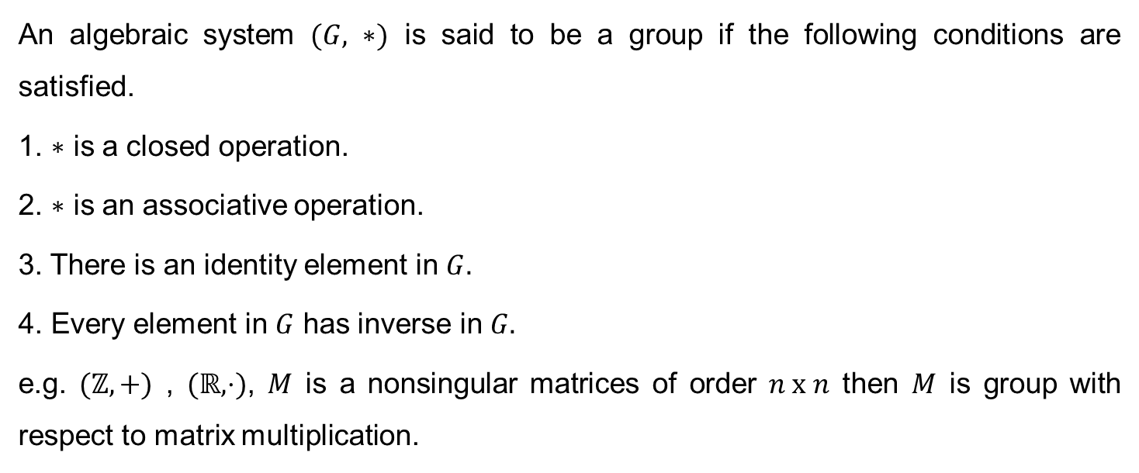
Group
An algebraic system $(G, ∗)$ is said to be a group if the following conditions are satisfied.
1. $∗$ is a closed operation.
2. $∗$ is an associative operation.
3. There is an identity element in $G.$
4. Every element in $G$ has inverse in $G.$
e.g. $(ℤ,+)$ , $(ℝ,⋅)$, $M$ is a nonsingular matrices of order $n x n$ then $M$ is group with respect to matrix multiplication.

Slide 16
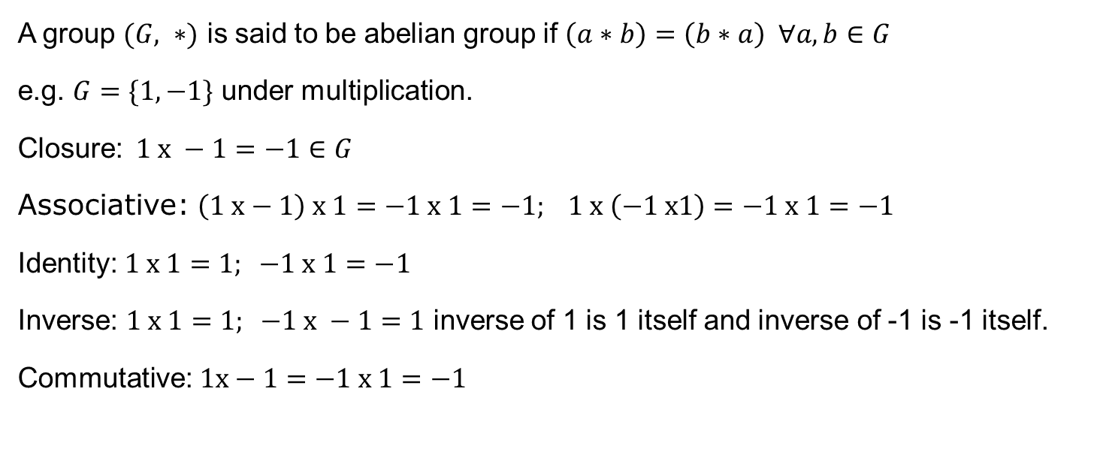
Abelian Group
A group $(G, ∗)$ is said to be abelian group if $\left(a∗b\right)=\left(b∗a\right) ∀a, b∈G$
e.g. $G=\{1, −1\}$ under multiplication.
Closure:$1 x −1=−1∈G$
Associative: $\left(1 x−1\right) x 1=−1 x 1=−1; 1 x \left(−1 x1\right)=−1 x 1=−1$
Identity: $1 x 1=1; −1 x 1=−1$
Inverse: $1 x 1=1; −1 x −1=1$ inverse of 1 is 1 itself and inverse of -1 is -1 itself.
Commutative: $1x−1=−1 x 1=−1$

Slide 17

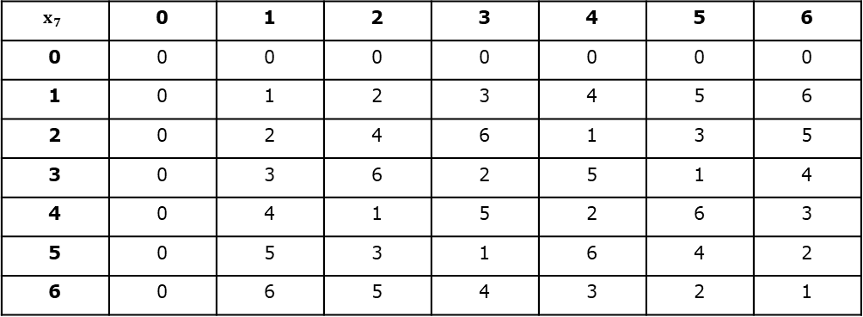
Multiplication of Modulo 7
Cayley Table
$8≡1(mod 7)$ means
$8−1$ is divisible by 7
$$x_{7}$$ | 0 | 1 | 2 | 3 | 4 | 5 | 6
0 | 0 | 0 | 0 | 0 | 0 | 0 | 0
1 | 0 | 1 | 2 | 3 | 4 | 5 | 6
2 | 0 | 2 | 4 | 6 | 1 | 3 | 5
3 | 0 | 3 | 6 | 2 | 5 | 1 | 4
4 | 0 | 4 | 1 | 5 | 2 | 6 | 3
5 | 0 | 5 | 3 | 1 | 6 | 4 | 2
6 | 0 | 6 | 5 | 4 | 3 | 2 | 1

Slide 18
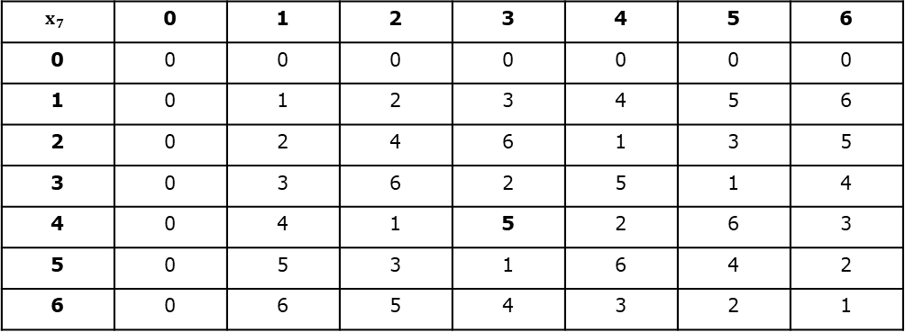

Multiplication of Modulo 7
Cayley Table
$$x_{7}$$ | 0 | 1 | 2 | 3 | 4 | 5 | 6
0 | 0 | 0 | 0 | 0 | 0 | 0 | 0
1 | 0 | 1 | 2 | 3 | 4 | 5 | 6
2 | 0 | 2 | 4 | 6 | 1 | 3 | 5
3 | 0 | 3 | 6 | 2 | 5 | 1 | 4
4 | 0 | 4 | 1 | 5 | 2 | 6 | 3
5 | 0 | 5 | 3 | 1 | 6 | 4 | 2
6 | 0 | 6 | 5 | 4 | 3 | 2 | 1
$$4 x 3=12=1 x 7+5$$
$$≡5(mod 7)$$

Slide 19
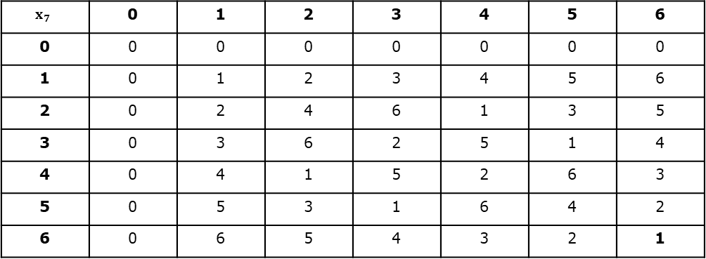

Multiplication of Modulo 7
Cayley Table
$$x_{7}$$ | 0 | 1 | 2 | 3 | 4 | 5 | 6
0 | 0 | 0 | 0 | 0 | 0 | 0 | 0
1 | 0 | 1 | 2 | 3 | 4 | 5 | 6
2 | 0 | 2 | 4 | 6 | 1 | 3 | 5
3 | 0 | 3 | 6 | 2 | 5 | 1 | 4
4 | 0 | 4 | 1 | 5 | 2 | 6 | 3
5 | 0 | 5 | 3 | 1 | 6 | 4 | 2
6 | 0 | 6 | 5 | 4 | 3 | 2 | 1
$$6 x 6=36=5 x 7+1$$
$$≡1(mod 7)$$

Slide 20
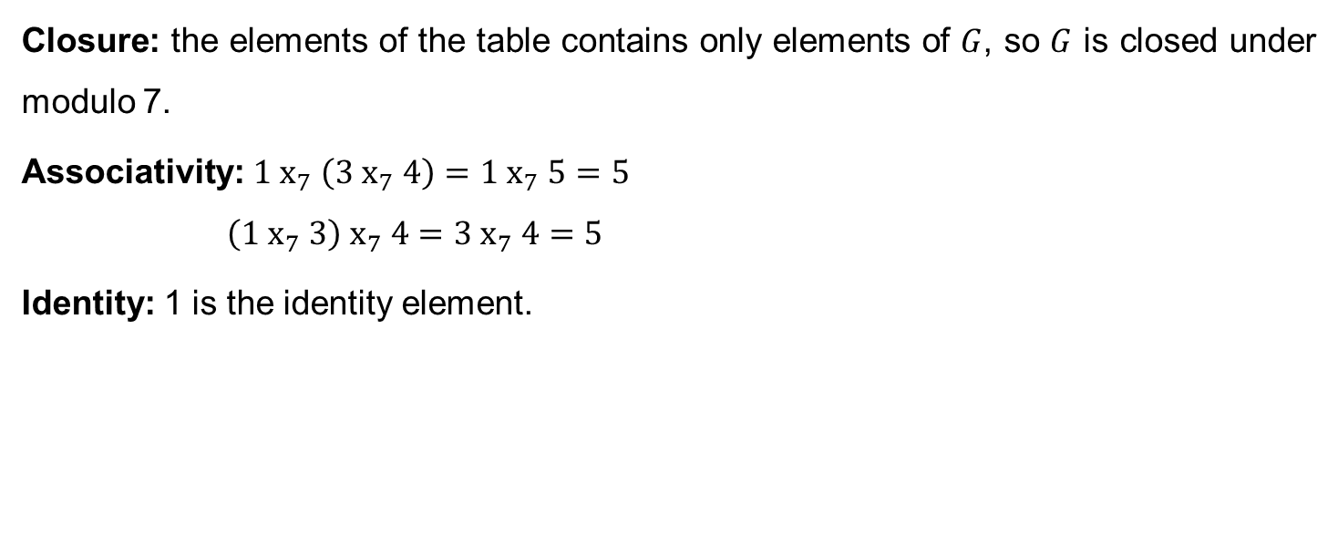
Multiplication of Modulo 7
Closure: the elements of the table contains only elements of $G$, so $G$ is closed under modulo 7.
Associativity: $1 x_{7} \left(3 x_{7} 4\right)=1{ x}_{7} 5=5$
$$\left(1 x_{7} 3\right) x_{7} 4=3{ x}_{7} 4=5$$
Identity: 1 is the identity element.

Slide 21
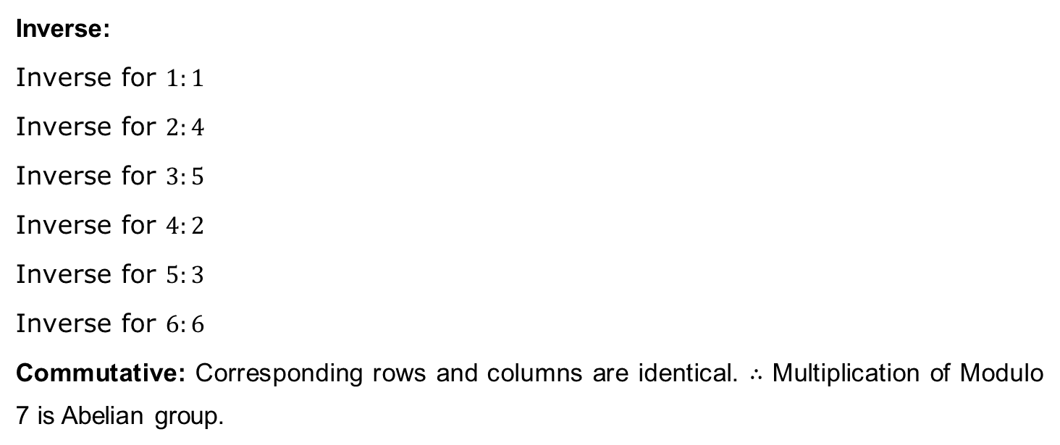
Multiplication of Modulo 7
Inverse:
Inverse for $1:1$
Inverse for $2:4$
Inverse for $3:5$
Inverse for $4:2$
Inverse for $5:3$
Inverse for $6:6$
Commutative: Corresponding rows and columns are identical. $∴$ Multiplication of Modulo 7 is Abelian group.

Slide 22

Order of a group
The number of elements in a group $G$ is called the order of the group and it is denoted by $O(G)$.
If $O(G)$ is finite, then $G$ is finite.

Slide 23
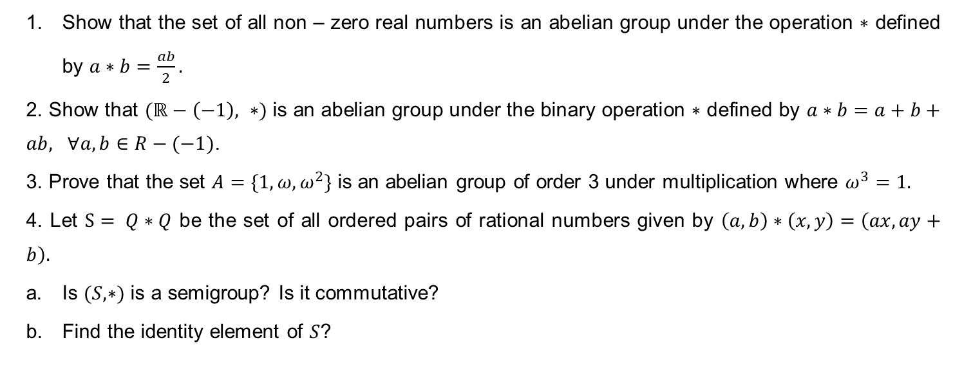
Problems
Show that the set of all non – zero real numbers is an abelian group under the operation $∗$ defined by $a∗b=\frac{ab}{2}.$
2. Show that $(ℝ−\left(−1\right), ∗)$ is an abelian group under the binary operation $∗$ defined by $a∗b=a+b+ab, ∀a,b∈R−(−1)$.
3. Prove that the set $A=\{1, ω, ω^{2}\}$ is an abelian group of order 3 under multiplication where $ω^{3}=1.$
4. Let $S= Q∗Q$ be the set of all ordered pairs of rational numbers given by $\left(a,b\right)∗\left(x,y\right)=\left(ax, ay+b\right).$
Is $(S,∗)$ is a semigroup? Is it commutative?
Find the identity element of $S$?

Slide 24
Thank You

